Slide 1
Credit Risk Management, Stocks Analysis and Regression
Kapil Agrawal,
2014B3A3579P,
Bits Pilani, Pilani Campus

Slide 2
Risk Management
Risk management is the process of identification, analysis and either acceptance or mitigation of uncertainty in investment decision-making.
Simply put, risk management is a two-step process - determining what risks exist in an investment and then handling those risks in a way best-suited to your investment objectives.
Risk management occurs everywhere in the financial world.

Slide 3
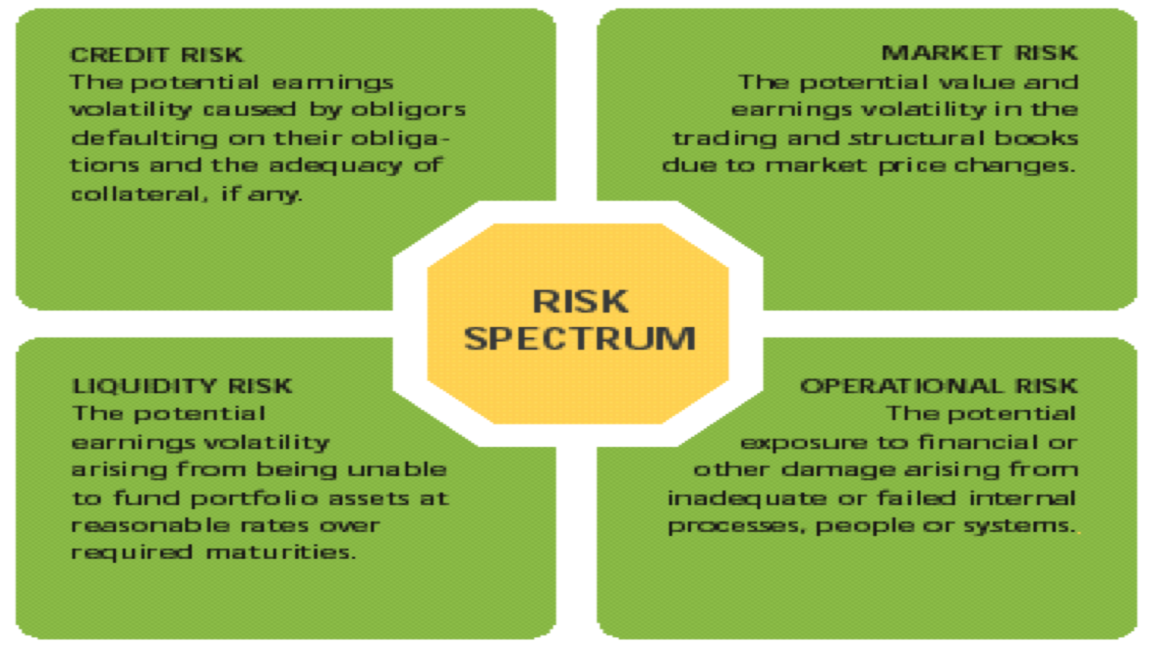
Different types of financial risk

Slide 4
Credit Risk
Credit risk is defined as the potential that a bank borrower or counterparty will fail to meet its obligations in accordance with agreed terms.
In simple words, It measures how much the borrower’s deviates from his/her promises.
In Credit Risk Management, the term “DEFAULT” means the situation where the credit risk occurs.

Slide 5
Credit Risk Management
Credit risk is the potential loss due to the nonperformance of a financial contract, or financial aspects of nonperformance in any contract. Assessment time horizon: typically one year .
The main difference between Market Risk and Credit Risk is their time of assessment that is their time of evaluation.
Credit risk is generally more important than market risk for banks.
Many credit risk drivers relate to market risk drivers, like the impact of market conditions on default probabilities.

Slide 6
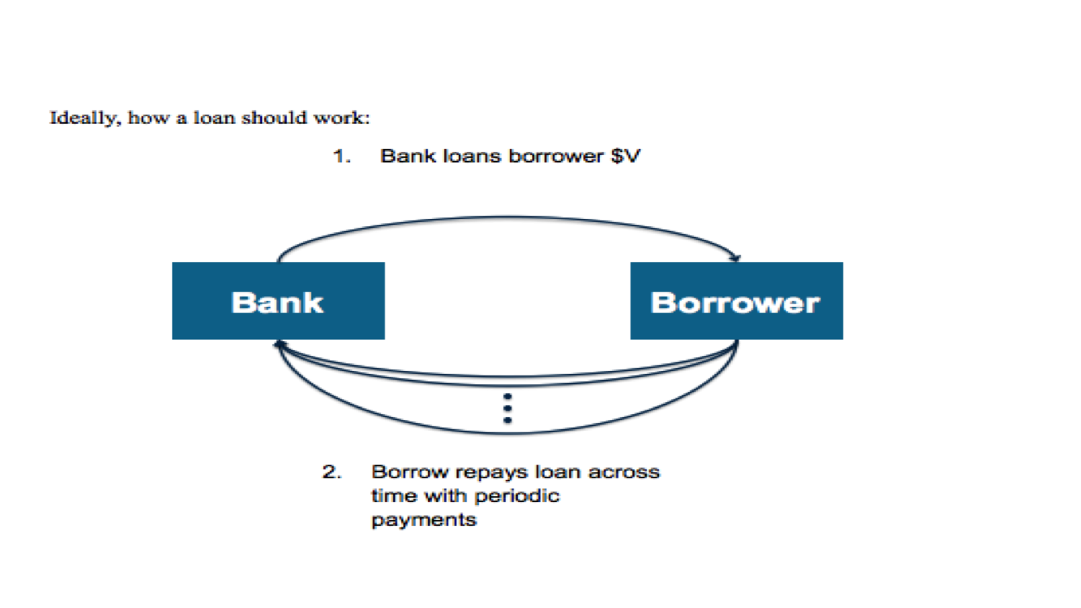
Credit Risk Management

Slide 7
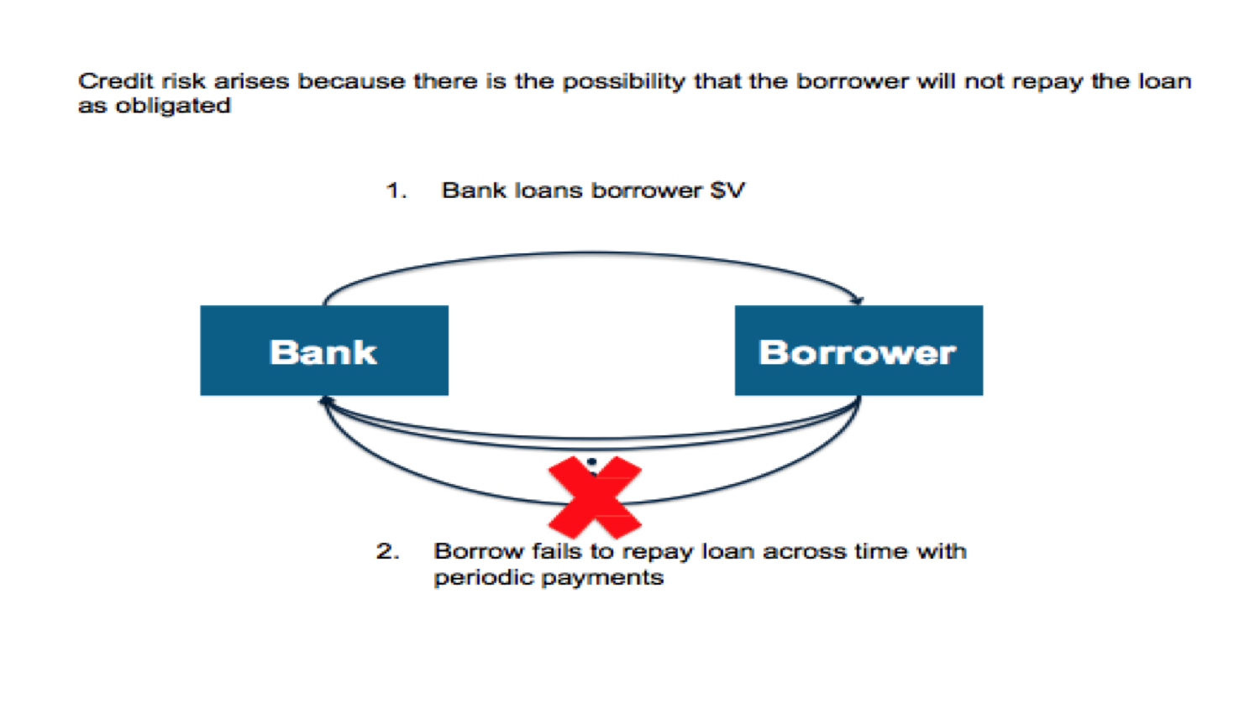
Credit Risk Management

Slide 8
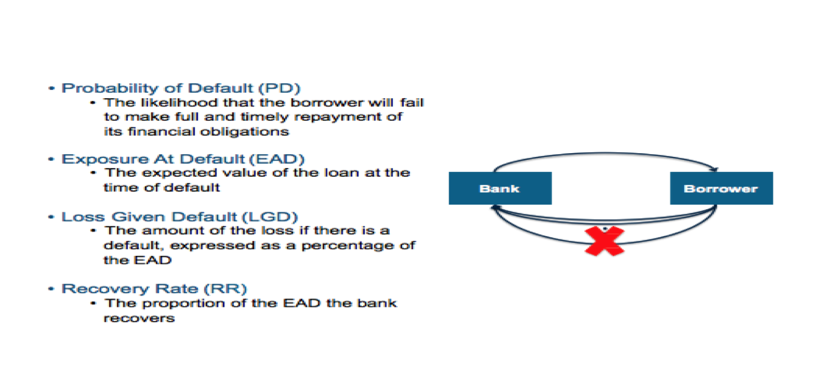
Important terms used in Credit Risk Management

Slide 9
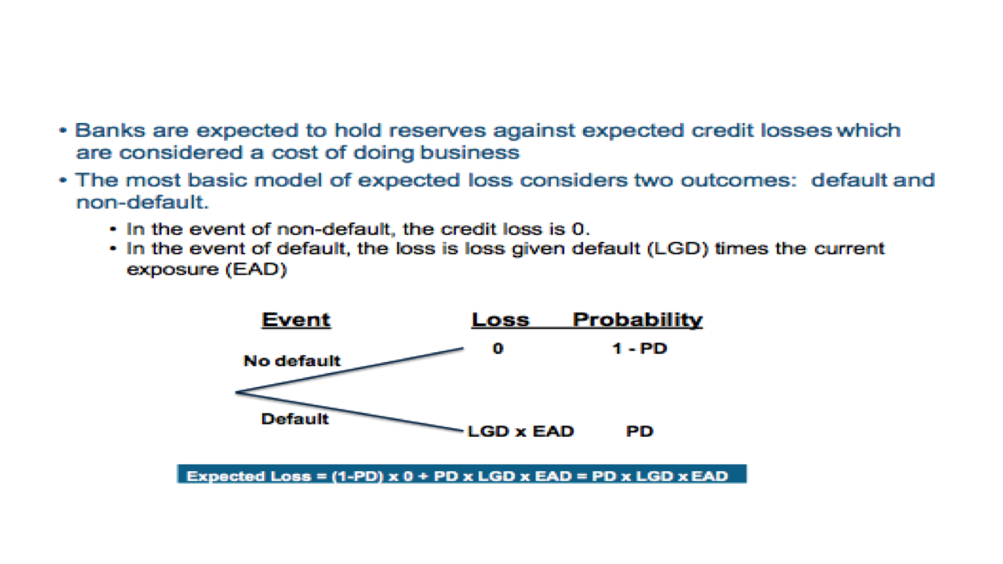
Calculation of Credit loss

Slide 10
Stocks Analysis
Analyzing monthly values of the stocks prices of the company.
Code to sort the monthly average values of stock prices data for different companies.
Can be useful in making Investment decisions.
Can be used by the investors to analyze the trends in the stocks prices of the companies.

Slide 11
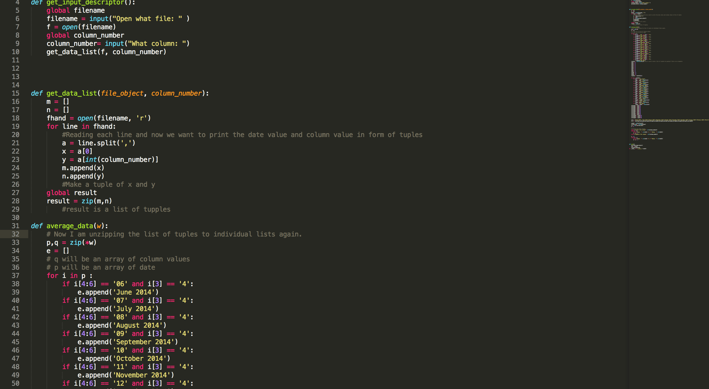
Python code to fetch stocks price values from the system

Slide 12
Regression Analysis
Regression analysis is a statistical process for estimating the relationships among variables
Regression analysis helps one understand how the typical value of the dependent variable changes when any one of the independent variables is varied, while the other independent variables are held fixed.
It can be performed using Excel, Stata, StatMac, etc.

Slide 13
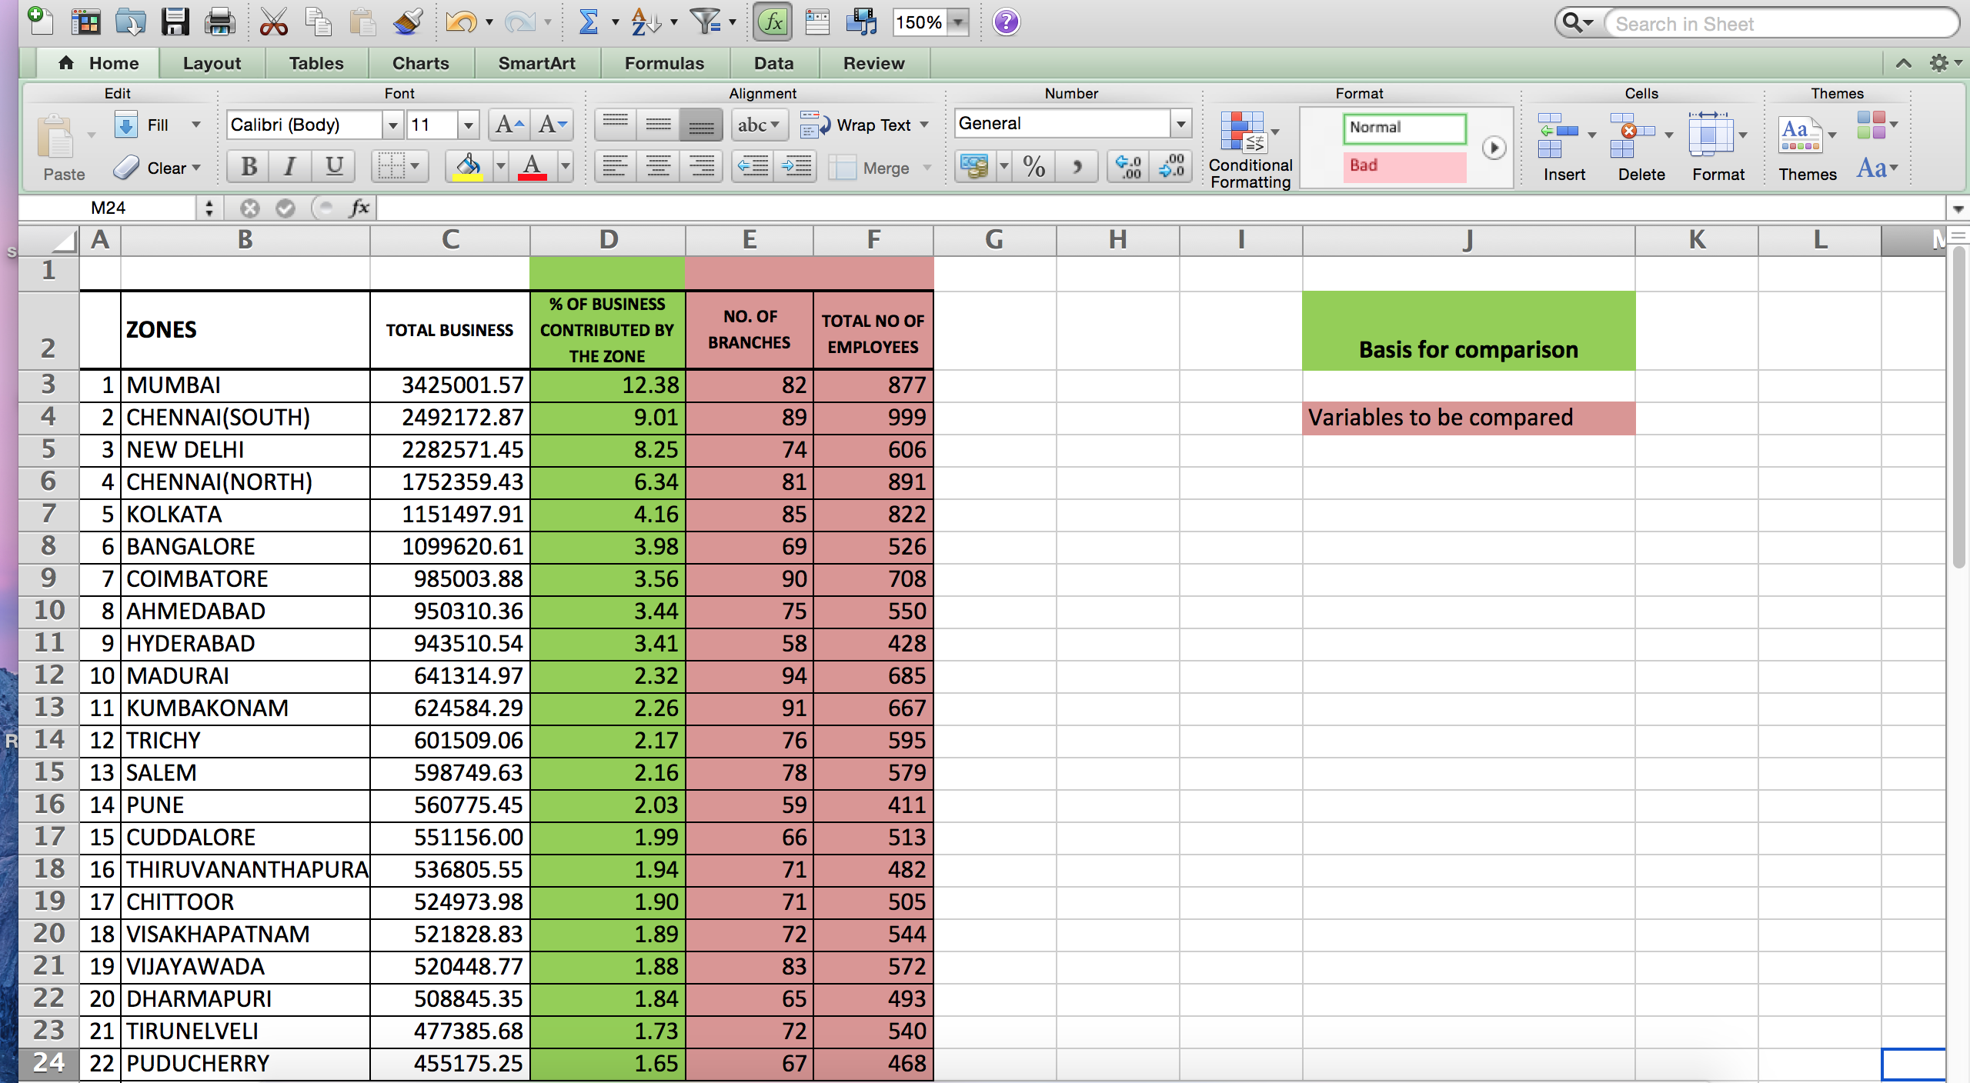
Indian Bank Data

Slide 14
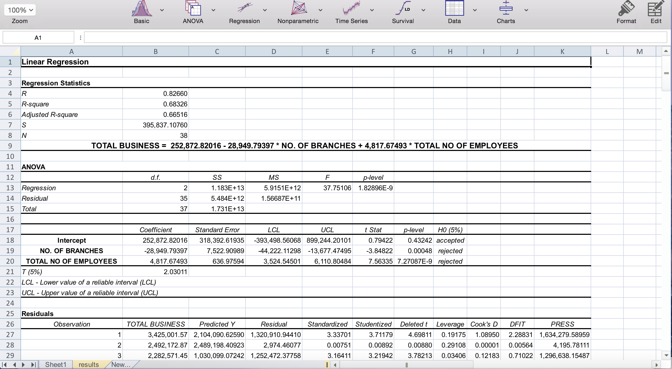
Result of the performed regression

Slide 15
Conclusions from the performed Regression Analysis
The regression result obtained was :
TOTAL BUSINESS = 252,872.82 - 28,949.8 * NO. OF BRANCHES + 4817.68 * TOTAL NO OF EMPLOYEES
Variable | p-values | Ho (5% significance)
No. of Branches | 0.00048 | rejected
Total No. of Employees | 7.27087E-9 | rejected

Slide 16
Effect of Total number of branches and Total number of employees on Total business value
Value of correlation is 0.82660.
Coefficient of Determination which is R square is 0.68 which implies that 68% of the variation in the variable total business is explained by the two variables no. of branches and total number of employees.
As the p value of both the independent variable is less than 5% significance level both the coefficients are significant indicating that total business depends on both no. of branches and total number of employees (using t test).

Slide 17
Interpretation of the regression result
Total Business is negatively correlated with No. of branches. It also means that if we increase No. of branches by 1, Total business will decrease by 28,949.79 units. But, it feels little strange because here we did not consider the other factors like in which city of the branch, demographic properties of the branch like location of the branch, population of the society near the branch area.
For examples, Mumbai has total business of 34,25,001.57 units with number of branches being 82 and Kumbakonam has total business of 624584.29 units with total number of branches being 91.

Slide 18


